Slide 1
Divide and Conquer
Marzieh Eskandari
NJIT

Slide 2
Guess a number!
Guess an integer 1 ≤ x ≤ 8 by asking at most three questions!
x < 5
yes
No
x < 3
x < 7
yes
No
yes
No
x < 2
x < 4
x < 6
x < 8
No
yes
yes
yes
No
yes
No
No
1
2
3
4
5
6
7
8

Slide 3
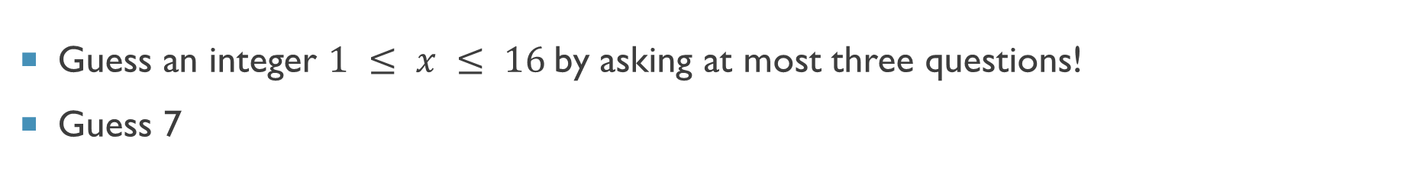
Guess a number!
Guess an integer $1 ≤ x ≤ 16$by asking at most three questions!
Guess 7
1 | 2 | 3 | 4 | 5 | 6 | 7 | 8 | 9 | 10 | 11 | 12 | 13 | 14 | 15 | 16
1 | 2 | 3 | 4 | 5 | 6 | 7 | 8 | 9 | 10 | 11 | 12 | 13 | 14 | 15 | 16
x<9??
1 | 2 | 3 | 4 | 5 | 6 | 7 | 8 | 9 | 10 | 11 | 12 | 13 | 14 | 15 | 16
x<5??
1 | 2 | 3 | 4 | 5 | 6 | 7 | 8 | 9 | 10 | 11 | 12 | 13 | 14 | 15 | 16
x<7??
1 | 2 | 3 | 4 | 5 | 6 | 7 | 8 | 9 | 10 | 11 | 12 | 13 | 14 | 15 | 16
x<8??
1 | 2 | 3 | 4 | 5 | 6 | 7 | 8 | 9 | 10 | 11 | 12 | 13 | 14 | 15 | 16

Slide 4
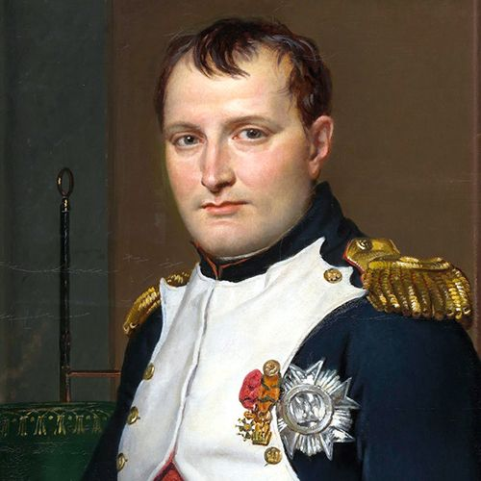
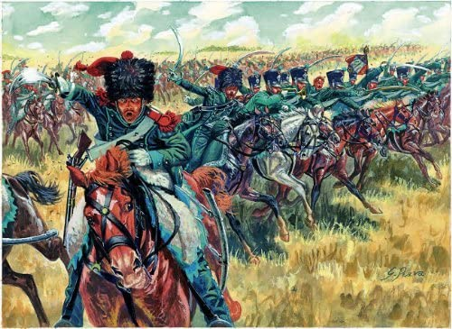
Introduction
Napoleon

Slide 5
Definition
Divide the problem into a number of subproblems that are smaller instances of the same problem.
Conquer the subproblems by solving them recursively. If they are small enough, solve the subproblems as base cases.
Combine the solutions to the subproblems into the solution for the original problem.

Slide 6
Example 1: Quicksort
Divide the list into two smaller list: less than pivot and greater than pivot.
Conquer the subproblems by sorting the sublists recursively.
Combine the sorted sublists to obtain the sorted main list.

Slide 7
Quicksort: Divide
Divide the list into two smaller list: less than pivot and greater than pivot.
40
20
10
80
60
50
7
30
100
< pivot
> pivot
7
20
10
30
40
50
60
80
100

Slide 8
Example 2: Mergesort
Divide the list into two equal size sublists.
Conquer the subproblems by sorting the lists recursively.
Combine(Merge) the sorted lists to obtain the sorted list.

Slide 9
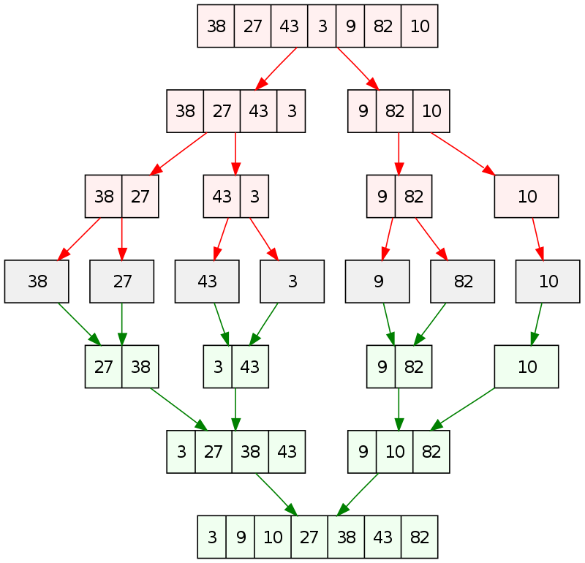
Mergesort

Slide 10

Example 3: Strassen’s Matrix Multiplication
7 | 1 | 4 | 5 | 6 | 7 | 8 | 9
1 | 2 | 4 | 6 | 3 | 5 | 8 | 3
5 | 3 | 6 | 7 | 4 | 1 | 3 | 2
0 | 4 | 0 | 6 | 7 | 5 | 7 | 2
0 | 4 | 6 | 7 | 0 | 1 | 6 | 3
8 | 9 | 4 | 6 | 3 | 5 | 8 | 4
4 | 6 | 6 | 7 | 4 | 1 | 3 | 6
2 | 0 | 0 | 6 | 7 | 5 | 7 | 0
$$n^{2}$$
nxn

Slide 11


Example 3: Strassen’s Matrix Multiplication
7 | 5
3 | 2
1 | 4
8 | 6
7+1 | 5+4
3+8 | 2+6
$$+$$
$$=$$

Slide 12

Example 3: Strassen’s Matrix Multiplication
11 2 7 7 10 7 14 16
8 7 11 8 10 11 15 6
5 4 12 10 4 5 9 5
3 9 8 10 10 11 14 6
4 5 9 13 4 1 12 10
15 14 11 6 10 11 15 4
4 12 13 7 8 1 9 13
8 7 0 12 14 11 14 0
7 | 1 | 4 | 5 | 6 | 7 | 8 | 9
1 | 2 | 4 | 6 | 3 | 5 | 8 | 3
5 | 3 | 6 | 7 | 4 | 1 | 3 | 2
0 | 4 | 0 | 6 | 7 | 5 | 7 | 2
0 | 4 | 6 | 7 | 0 | 1 | 6 | 3
8 | 9 | 4 | 6 | 3 | 5 | 8 | 4
4 | 6 | 6 | 7 | 4 | 1 | 3 | 6
2 | 0 | 0 | 6 | 7 | 5 | 7 | 0
4 | 1 | 3 | 2 | 4 | 0 | 6 | 7
7 | 5 | 7 | 2 | 7 | 6 | 7 | 0
0 | 1 | 6 | 3 | 0 | 4 | 6 | 3
3 | 5 | 8 | 4 | 3 | 6 | 7 | 4
4 | 1 | 3 | 6 | 4 | 0 | 6 | 7
7 | 5 | 7 | 0 | 7 | 6 | 7 | 0
0 | 6 | 7 | 0 | 4 | 0 | 6 | 7
6 | 7 | 0 | 6 | 7 | 6 | 7 | 0
+
=
$$n^{2}$$

Slide 13


Example 3: Strassen’s Matrix Multiplication
7 | 5
3 | 2
1 | 4
8 | 6
7x1+5x8 | 7x4+5x6
3x1+2x8 | 3x4+2x6
$$×$$
$$=$$

Slide 14
Example 3: Strassen’s Matrix Multiplication
7 | 5
3 | 2
1 | 4
8 | 6
7x1+5x8 | 7x4+5x6
3x1+2x8 | 3x4+2x6
$$×$$
$$=$$

Slide 15
Example 3: Strassen’s Matrix Multiplication
7 | 1 | 4 | 5 | 6 | 7 | 8 | 9
1 | 2 | 4 | 6 | 3 | 5 | 8 | 3
5 | 3 | 6 | 7 | 4 | 1 | 3 | 2
0 | 4 | 0 | 6 | 7 | 5 | 7 | 2
0 | 4 | 6 | 7 | 0 | 1 | 6 | 3
8 | 9 | 4 | 6 | 3 | 5 | 8 | 4
4 | 6 | 6 | 7 | 4 | 1 | 3 | 6
2 | 0 | 0 | 6 | 7 | 5 | 7 | 0
177 | 193 | 215 | 138 | 218 | 148 | 304 | 179
101 | 142 | 189 | 78 | 136 | 112 | 208 | 120
97 | 102 | 168 | 98 | 111 | 102 | 199 | 130
121 | 138 | 181 | 86 | 151 | 102 | 203 | 122
74 | 123 | 169 | 72 | 101 | 114 | 177 | 88
184 | 191 | 259 | 112 | 220 | 160 | 306 | 169
138 | 144 | 186 | 126 | 156 | 144 | 242 | 123
89 | 106 | 159 | 70 | 117 | 66 | 173 | 136
4 | 1 | 3 | 2 | 4 | 0 | 6 | 7
7 | 5 | 7 | 2 | 7 | 6 | 7 | 0
0 | 1 | 6 | 3 | 0 | 4 | 6 | 3
3 | 5 | 8 | 4 | 3 | 6 | 7 | 4
4 | 1 | 3 | 6 | 4 | 0 | 6 | 7
7 | 5 | 7 | 0 | 7 | 6 | 7 | 0
0 | 6 | 7 | 0 | 4 | 0 | 6 | 7
6 | 7 | 0 | 6 | 7 | 6 | 7 | 0
x
=

Slide 16
Example 3: Strassen’s Matrix Multiplication
7 | 1 | 4 | 5 | 6 | 7 | 8 | 9
1 | 2 | 4 | 6 | 3 | 5 | 8 | 3
5 | 3 | 6 | 7 | 4 | 1 | 3 | 2
0 | 4 | 0 | 6 | 7 | 5 | 7 | 2
0 | 4 | 6 | 7 | 0 | 1 | 6 | 3
8 | 9 | 4 | 6 | 3 | 5 | 8 | 4
4 | 6 | 6 | 7 | 4 | 1 | 3 | 6
2 | 0 | 0 | 6 | 7 | 5 | 7 | 0
177 | 193 | 215 | 138 | 218 | 148 | 304 | 179
101 | 142 | 189 | 78 | 136 | 112 | 208 | 120
97 | 102 | 168 | 98 | 111 | 102 | 199 | 130
121 | 138 | 181 | 86 | 151 | 102 | 203 | 122
74 | 123 | 169 | 72 | 101 | 114 | 177 | 88
184 | 191 | 259 | 112 | 220 | 160 | 306 | 169
138 | 144 | 186 | 126 | 156 | 144 | 242 | 123
89 | 106 | 159 | 70 | 117 | 66 | 173 | 136
4 | 1 | 3 | 2 | 4 | 0 | 6 | 7
7 | 5 | 7 | 2 | 7 | 6 | 7 | 0
0 | 1 | 6 | 3 | 0 | 4 | 6 | 3
3 | 5 | 8 | 4 | 3 | 6 | 7 | 4
4 | 1 | 3 | 6 | 4 | 0 | 6 | 7
7 | 5 | 7 | 0 | 7 | 6 | 7 | 0
0 | 6 | 7 | 0 | 4 | 0 | 6 | 7
6 | 7 | 0 | 6 | 7 | 6 | 7 | 0
x
=

Slide 17

Example 3: Strassen’s Matrix Multiplication
7 | 1 | 4 | 5 | 6 | 7 | 8 | 9
1 | 2 | 4 | 6 | 3 | 5 | 8 | 3
5 | 3 | 6 | 7 | 4 | 1 | 3 | 2
0 | 4 | 0 | 6 | 7 | 5 | 7 | 2
0 | 4 | 6 | 7 | 0 | 1 | 6 | 3
8 | 9 | 4 | 6 | 3 | 5 | 8 | 4
4 | 6 | 6 | 7 | 4 | 1 | 3 | 6
2 | 0 | 0 | 6 | 7 | 5 | 7 | 0
177 | 193 | 215 | 138 | 218 | 148 | 304 | 179
101 | 142 | 189 | 78 | 136 | 112 | 208 | 120
97 | 102 | 168 | 98 | 111 | 102 | 199 | 130
121 | 138 | 181 | 86 | 151 | 102 | 203 | 122
74 | 123 | 169 | 72 | 101 | 114 | 177 | 88
184 | 191 | 259 | 112 | 220 | 160 | 306 | 169
138 | 144 | 186 | 126 | 156 | 144 | 242 | 123
89 | 106 | 159 | 70 | 117 | 66 | 173 | 136
4 | 1 | 3 | 2 | 4 | 0 | 6 | 7
7 | 5 | 7 | 2 | 7 | 6 | 7 | 0
0 | 1 | 6 | 3 | 0 | 4 | 6 | 3
3 | 5 | 8 | 4 | 3 | 6 | 7 | 4
4 | 1 | 3 | 6 | 4 | 0 | 6 | 7
7 | 5 | 7 | 0 | 7 | 6 | 7 | 0
0 | 6 | 7 | 0 | 4 | 0 | 6 | 7
6 | 7 | 0 | 6 | 7 | 6 | 7 | 0
x
=
$${n−1→n^{2}\left(n−1\right)=O(n}^{3})$$

Slide 18

Example 3: Matrix Multiplication
C =A x B
nxn nxn nxn
for(i=0;i<n;i++)
for(j=0;j<n;j++)
{
C[i][j]=0;
for(k=0;k<n;k++)
C[i][j]+=A[i][k]*B[k][j];
}
$$O\left(n^{3}\right)→ O(n^{?})$$

Slide 19
Example 3: Strassen’s Matrix Multiplication
7 | 1 | 4 | 5 | 6 | 7 | 8 | 9
1 | 2 | 4 | 6 | 3 | 5 | 8 | 3
5 | 3 | 6 | 7 | 4 | 1 | 3 | 2
0 | 4 | 0 | 6 | 7 | 5 | 7 | 2
0 | 4 | 6 | 7 | 0 | 1 | 6 | 3
8 | 9 | 4 | 6 | 3 | 5 | 8 | 4
4 | 6 | 6 | 7 | 4 | 1 | 3 | 6
2 | 0 | 0 | 6 | 7 | 5 | 7 | 0
4 | 1 | 3 | 2 | 4 | 0 | 6 | 7
7 | 5 | 7 | 2 | 7 | 6 | 7 | 0
0 | 1 | 6 | 3 | 0 | 4 | 6 | 3
3 | 5 | 8 | 4 | 3 | 6 | 7 | 4
4 | 1 | 3 | 6 | 4 | 0 | 6 | 7
7 | 5 | 7 | 0 | 7 | 6 | 7 | 0
0 | 6 | 7 | 0 | 4 | 0 | 6 | 7
6 | 7 | 0 | 6 | 7 | 6 | 7 | 0
x
= ?

Slide 20
Example 3: Strassen’s Matrix Multiplication
7 | 1 | 4 | 5 | 6 | 7 | 8 | 9
1 | 2 | 4 | 6 | 3 | 5 | 8 | 3
5 | 3 | 6 | 7 | 4 | 1 | 3 | 2
0 | 4 | 0 | 6 | 7 | 5 | 7 | 2
0 | 4 | 6 | 7 | 0 | 1 | 6 | 3
8 | 9 | 4 | 6 | 3 | 5 | 8 | 4
4 | 6 | 6 | 7 | 4 | 1 | 3 | 6
2 | 0 | 0 | 6 | 7 | 5 | 7 | 0
177 | 193 | 215 | 138 | 218 | 148 | 304 | 179
101 | 142 | 189 | 78 | 136 | 112 | 208 | 120
97 | 102 | 168 | 98 | 111 | 102 | 199 | 130
121 | 138 | 181 | 86 | 151 | 102 | 203 | 122
74 | 123 | 169 | 72 | 101 | 114 | 177 | 88
184 | 191 | 259 | 112 | 220 | 160 | 306 | 169
138 | 144 | 186 | 126 | 156 | 144 | 242 | 123
89 | 106 | 159 | 70 | 117 | 66 | 173 | 136
4 | 1 | 3 | 2 | 4 | 0 | 6 | 7
7 | 5 | 7 | 2 | 7 | 6 | 7 | 0
0 | 1 | 6 | 3 | 0 | 4 | 6 | 3
3 | 5 | 8 | 4 | 3 | 6 | 7 | 4
4 | 1 | 3 | 6 | 4 | 0 | 6 | 7
7 | 5 | 7 | 0 | 7 | 6 | 7 | 0
0 | 6 | 7 | 0 | 4 | 0 | 6 | 7
6 | 7 | 0 | 6 | 7 | 6 | 7 | 0
x
=

Slide 21
Example 3: Strassen’s Matrix Multiplication
7 | 1 | 4 | 5 | 6 | 7 | 8 | 9
1 | 2 | 4 | 6 | 3 | 5 | 8 | 3
5 | 3 | 6 | 7 | 4 | 1 | 3 | 2
0 | 4 | 0 | 6 | 7 | 5 | 7 | 2
0 | 4 | 6 | 7 | 0 | 1 | 6 | 3
8 | 9 | 4 | 6 | 3 | 5 | 8 | 4
4 | 6 | 6 | 7 | 4 | 1 | 3 | 6
2 | 0 | 0 | 6 | 7 | 5 | 7 | 0
177 | 193 | 215 | 138 | 218 | 148 | 304 | 179
101 | 142 | 189 | 78 | 136 | 112 | 208 | 120
97 | 102 | 168 | 98 | 111 | 102 | 199 | 130
121 | 138 | 181 | 86 | 151 | 102 | 203 | 122
74 | 123 | 169 | 72 | 101 | 114 | 177 | 88
184 | 191 | 259 | 112 | 220 | 160 | 306 | 169
138 | 144 | 186 | 126 | 156 | 144 | 242 | 123
89 | 106 | 159 | 70 | 117 | 66 | 173 | 136
4 | 1 | 3 | 2 | 4 | 0 | 6 | 7
7 | 5 | 7 | 2 | 7 | 6 | 7 | 0
0 | 1 | 6 | 3 | 0 | 4 | 6 | 3
3 | 5 | 8 | 4 | 3 | 6 | 7 | 4
4 | 1 | 3 | 6 | 4 | 0 | 6 | 7
7 | 5 | 7 | 0 | 7 | 6 | 7 | 0
0 | 6 | 7 | 0 | 4 | 0 | 6 | 7
6 | 7 | 0 | 6 | 7 | 6 | 7 | 0
x
=

Slide 22
Example 3: Strassen’s Matrix Multiplication
7 | 1 | 4 | 5 | 6 | 7 | 8 | 9
1 | 2 | 4 | 6 | 3 | 5 | 8 | 3
5 | 3 | 6 | 7 | 4 | 1 | 3 | 2
0 | 4 | 0 | 6 | 7 | 5 | 7 | 2
0 | 4 | 6 | 7 | 0 | 1 | 6 | 3
8 | 9 | 4 | 6 | 3 | 5 | 8 | 4
4 | 6 | 6 | 7 | 4 | 1 | 3 | 6
2 | 0 | 0 | 6 | 7 | 5 | 7 | 0
177 | 193 | 215 | 138 | 218 | 148 | 304 | 179
101 | 142 | 189 | 78 | 136 | 112 | 208 | 120
97 | 102 | 168 | 98 | 111 | 102 | 199 | 130
121 | 138 | 181 | 86 | 151 | 102 | 203 | 122
74 | 123 | 169 | 72 | 101 | 114 | 177 | 88
184 | 191 | 259 | 112 | 220 | 160 | 306 | 169
138 | 144 | 186 | 126 | 156 | 144 | 242 | 123
89 | 106 | 159 | 70 | 117 | 66 | 173 | 136
4 | 1 | 3 | 2 | 4 | 0 | 6 | 7
7 | 5 | 7 | 2 | 7 | 6 | 7 | 0
0 | 1 | 6 | 3 | 0 | 4 | 6 | 3
3 | 5 | 8 | 4 | 3 | 6 | 7 | 4
4 | 1 | 3 | 6 | 4 | 0 | 6 | 7
7 | 5 | 7 | 0 | 7 | 6 | 7 | 0
0 | 6 | 7 | 0 | 4 | 0 | 6 | 7
6 | 7 | 0 | 6 | 7 | 6 | 7 | 0
x
=

Slide 23
Example 3: Strassen’s Matrix Multiplication
7 | 1 | 4 | 5 | 6 | 7 | 8 | 9
1 | 2 | 4 | 6 | 3 | 5 | 8 | 3
5 | 3 | 6 | 7 | 4 | 1 | 3 | 2
0 | 4 | 0 | 6 | 7 | 5 | 7 | 2
0 | 4 | 6 | 7 | 0 | 1 | 6 | 3
8 | 9 | 4 | 6 | 3 | 5 | 8 | 4
4 | 6 | 6 | 7 | 4 | 1 | 3 | 6
2 | 0 | 0 | 6 | 7 | 5 | 7 | 0
177 | 193 | 215 | 138 | 218 | 148 | 304 | 179
101 | 142 | 189 | 78 | 136 | 112 | 208 | 120
97 | 102 | 168 | 98 | 111 | 102 | 199 | 130
121 | 138 | 181 | 86 | 151 | 102 | 203 | 122
74 | 123 | 169 | 72 | 101 | 114 | 177 | 88
184 | 191 | 259 | 112 | 220 | 160 | 306 | 169
138 | 144 | 186 | 126 | 156 | 144 | 242 | 123
89 | 106 | 159 | 70 | 117 | 66 | 173 | 136
4 | 1 | 3 | 2 | 4 | 0 | 6 | 7
7 | 5 | 7 | 2 | 7 | 6 | 7 | 0
0 | 1 | 6 | 3 | 0 | 4 | 6 | 3
3 | 5 | 8 | 4 | 3 | 6 | 7 | 4
4 | 1 | 3 | 6 | 4 | 0 | 6 | 7
7 | 5 | 7 | 0 | 7 | 6 | 7 | 0
0 | 6 | 7 | 0 | 4 | 0 | 6 | 7
6 | 7 | 0 | 6 | 7 | 6 | 7 | 0
x
=

Slide 24
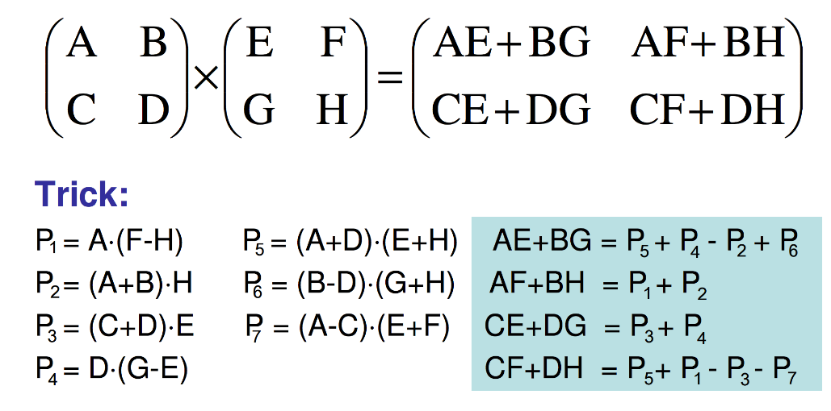
Example 3: Strassen’s Matrix Multiplication

Slide 25
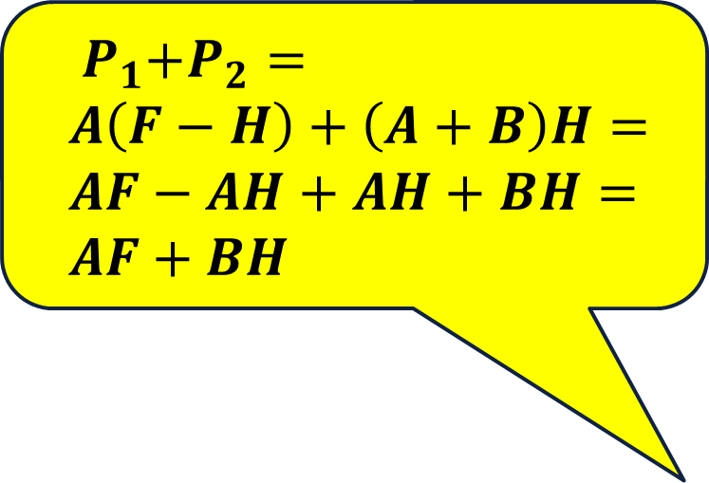
Example 3: Strassen’s Matrix Multiplication
$${ P}_{1}+P_{2}=$$
$$A\left(F−H\right)+\left(A+B\right)H=$$
$$AF−AH+AH+BH=$$
$$AF+BH$$

Slide 26
Example 3: Strassen’s Matrix Multiplication

Slide 27
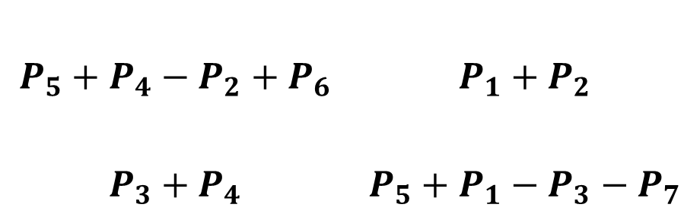
Example 3: Strassen’s Matrix Multiplication
$$P_{5}+P_{4}−P_{2}+P_{6}$$ | $${P_{1}+P}_{2}$$
$$P_{3}+P_{4}$$ | $$P_{5}+P_{1}−P_{3}−P_{7}$$

Slide 28
Example 3: Strassen’s Matrix Multiplication
7 | 1 | 4 | 5 | 6 | 7 | 8 | 9
1 | 2 | 4 | 6 | 3 | 5 | 8 | 3
5 | 3 | 6 | 7 | 4 | 1 | 3 | 2
0 | 4 | 0 | 6 | 7 | 5 | 7 | 2
0 | 4 | 6 | 7 | 0 | 1 | 6 | 3
8 | 9 | 4 | 6 | 3 | 5 | 8 | 4
4 | 6 | 6 | 7 | 4 | 1 | 3 | 6
2 | 0 | 0 | 6 | 7 | 5 | 7 | 0
4 | 1 | 3 | 2 | 4 | 0 | 6 | 7
7 | 5 | 7 | 2 | 7 | 6 | 7 | 0
0 | 1 | 6 | 3 | 0 | 4 | 6 | 3
3 | 5 | 8 | 4 | 3 | 6 | 7 | 4
4 | 1 | 3 | 6 | 4 | 0 | 6 | 7
7 | 5 | 7 | 0 | 7 | 6 | 7 | 0
0 | 6 | 7 | 0 | 4 | 0 | 6 | 7
6 | 7 | 0 | 6 | 7 | 6 | 7 | 0
x
=?

Slide 29
Example 3: Strassen’s Matrix Multiplication
Matrix Strassen(A, B, n):
if (n==1) return A*B
a, b, c, d = split(A)
e, f, g, h = split(B)
p1 = Strassen(a, f – h, n/2)
p2 = Strassen(a + b, h, n/2)
p3 = Strassen(c + d, e, n/2)
p4 = Strassen(d, g - e, n/2)
p5 = Strassen(a + d, e + h, n/2)
p6 = Strassen(b - d, g + h, n/2)
p7 = Strassen(a - c, e + f, n/2)
c11 = p5 + p4 - p2 + p6;
c12 = p1 + p2
c21 = p3 + p4
c22 = p1 + p5 - p3 - p7
return C

Slide 30















Matrix Strassen(A, B, n)
if (n==1) return A*B
a, b, c, d = split(A)
e, f, g, h = split(B)
p1 = Strassen(a, f – h, n/2)
p2 = Strassen(a + b, h, n/2)
p3 = Strassen(c + d, e, n/2)
p4 = Strassen(d, g - e, n/2)
p5 = Strassen(a + d, e + h, n/2)
p6 = Strassen(b - d, g + h, n/2)
p7 = Strassen(a - c, e + f, n/2)
c11 = p5 + p4 - p2 + p6
c12 = p1 + p2
c21 = p3 + p4
c22 = p1 + p5 - p3 - p7
return C
$$T(n)$$
$$T\left(n\right)=1$$
$$O(n^{2})$$
$$T\left(\frac{n}{ 2}\right)+\left(\frac{n}{2}\right)\left(\frac{n}{2}\right)$$
$$T\left(\frac{n}{ 2}\right)+\left(\frac{n}{2}\right)\left(\frac{n}{2}\right)$$
$$T\left(\frac{n}{ 2}\right)+\left(\frac{n}{2}\right)\left(\frac{n}{2}\right)$$
$$T\left(\frac{n}{ 2}\right)+\left(\frac{n}{2}\right)\left(\frac{n}{2}\right)$$
$$T\left(\frac{n}{ 2}\right)+2\left(\frac{n}{2}\right)\left(\frac{n}{2}\right)$$
$$T\left(\frac{n}{ 2}\right)+2\left(\frac{n}{2}\right)\left(\frac{n}{2}\right)$$
$$T\left(\frac{n}{ 2}\right)+2\left(\frac{n}{2}\right)\left(\frac{n}{2}\right)$$
$$3\left(\frac{n}{2}\right)\left(\frac{n}{2}\right)$$
$$\left(\frac{n}{2}\right)\left(\frac{n}{2}\right)$$
$$\left(\frac{n}{2}\right)\left(\frac{n}{2}\right)$$
$$3\left(\frac{n}{2}\right)\left(\frac{n}{2}\right)$$
$$T\left(n\right)=O\left(n^{2}\right)+7T\left(\frac{n}{2}\right)+18\left(\frac{n}{2}\right)\left(\frac{n}{2}\right)$$

Slide 31
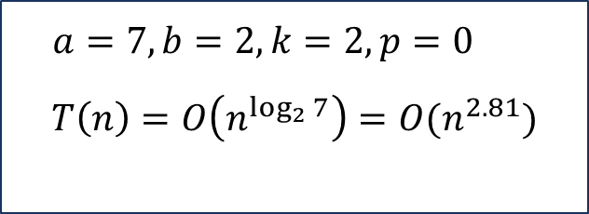

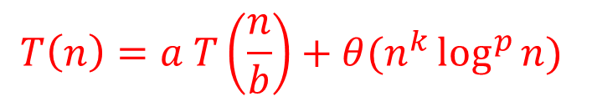
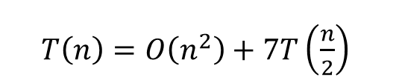
Strassen: Time Complexity-Master theorem
$T\left(n\right)=O\left(n^{2}\right)+7T\left(\frac{n}{2}\right)$
$$T\left(n\right)=a T\left(\frac{n}{b}\right)+θ(n^{k}\log^{p}{n) }$$
$a=7, b=2, k=2,p=0$
$$T\left(n\right)=O\left(n^{\log_{2}{7}}\right){=O(n}^{2.81})$$
$$if a > b^{k}, then T\left(n\right)= θ\left(n^{\log_{b}{a}}\right)$$

Slide 32
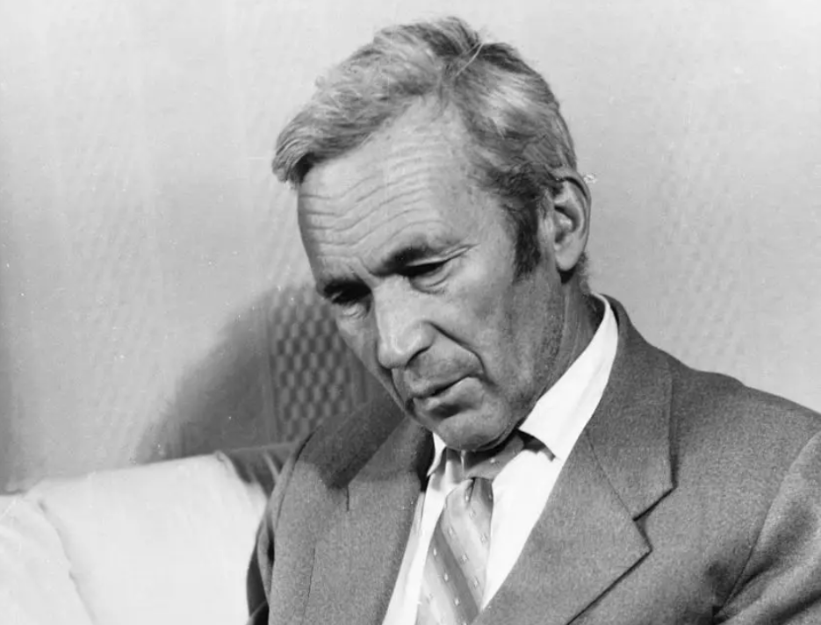
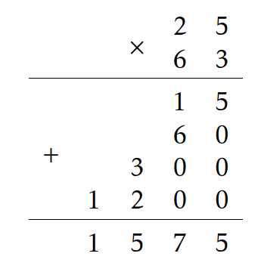
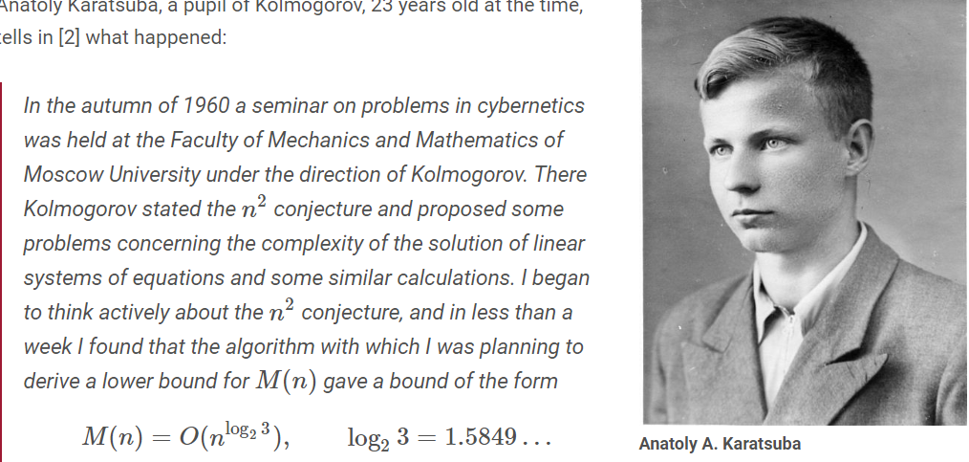
Example 4: Large Integer Multiplication
Andrey Kolmogorov

Slide 33
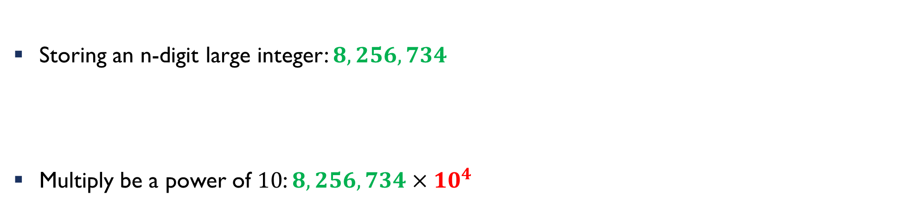
Example 4: Large Integer Multiplication
Storing an n-digit large integer: $8,256,734$
Multiply be a power of $10$: $8,256,734×{10}^{4}$
$$8$$ | $$2$$ | $$5$$ | $$6$$ | $$7$$ | $$3$$ | $$4$$
$$8$$ | $$2$$ | $$5$$ | $$6$$ | $$7$$ | $$3$$ | $$4$$ | $$0$$ | $$0$$ | $$0$$ | $$0$$

Slide 34
Example 4: Large Integer Multiplication
Adding two large integers: $850368000000+7519802000=?$
8
5
0
3
6
8
0
0
0
0
0
0
carry
7
5
1
9
8
0
2
0
0
0
0

Slide 35
L.I.M: Summation
8
5
0
3
6
8
0
0
0
0
0
0
carry
7
5
1
9
8
0
2
0
0
0
0
+
0
0
0
0
0
0
0
0
0
0
0
0
0

Slide 36
L.I.M: Summation
8
5
0
3
6
8
0
0
0
0
0
0
carry
+
7
5
1
9
8
0
2
0
0
0
0
0
0
0
0
0
0
0
0
0
0
0
0
0

Slide 37
L.I.M: Summation
8
5
0
3
6
8
0
0
0
0
0
0
carry
+
7
5
1
9
8
0
2
0
0
0
0
0
0
0
0
0
0
0
0
0
0
0
0
0

Slide 38
L.I.M: Summation
8
5
0
3
6
8
0
0
0
0
0
0
carry
+
7
5
1
9
8
0
2
0
0
0
0
0
0
0
0
0
0
0
0
0
0
0
0
0

Slide 39
L.I.M: Summation
8
5
0
3
6
8
0
0
0
0
0
0
carry
carry
7
5
1
9
8
0
2
0
0
0
0
+
0
0
0
0
0
0
0
0
0
0
2
0
0
0

Slide 40
8
5
0
3
6
8
0
0
0
0
0
0
carry
+
7
5
1
9
8
0
2
0
0
0
1
0
0
0
0
0
8
7
8
0
2
0
0
0

Slide 41
L.I.M: Summation
8
5
0
3
6
8
0
0
0
0
0
0
carry
+
7
5
1
9
8
0
2
0
0
0
0
0
0
0
0
0
0
0
0
0
2
0
0
0

Slide 42
L.I.M: Summation
8
5
0
3
6
8
0
0
0
0
0
0
carry
+
7
5
1
9
8
0
2
0
0
0
0
0
0
0
0
0
0
0
8
0
2
0
0
0

Slide 43
L.I.M: Summation
8
5
0
3
6
8
0
0
0
0
0
0
carry
+
7
5
1
9
8
0
2
0
0
0
0
0
0
0
0
0
0
7
8
0
2
0
0
0

Slide 44
L.I.M: Summation
8
5
0
3
6
8
0
0
0
0
0
0
carry
+
7
5
1
9
8
0
2
0
0
0
1
0
0
0
0
0
0
7
8
0
2
0
0
0

Slide 45
L.I.M: Summation
8
5
0
3
6
8
0
0
0
0
0
0
carry
+
7
5
1
9
8
0
2
0
0
0
1
0
0
0
0
0
8
7
8
0
2
0
0
0

Slide 46
L.I.M: Summation
8
5
0
3
6
8
0
0
0
0
0
0
carry
+
7
5
1
9
8
0
2
0
0
0
0
0
0
0
0
0
8
7
8
0
2
0
0
0

Slide 47
L.I.M: Summation
8
5
0
3
6
8
0
0
0
0
0
0
carry
+
7
5
1
9
8
0
2
0
0
0
0
0
0
0
0
8
8
7
8
0
2
0
0
0

Slide 48

L.I.M: Summation
8
5
0
3
6
8
0
0
0
0
0
0
carry
+
7
5
1
9
8
0
2
0
0
0
0
0
8
5
7
8
8
7
8
0
2
0
0
0
$$O(n)$$

Slide 49
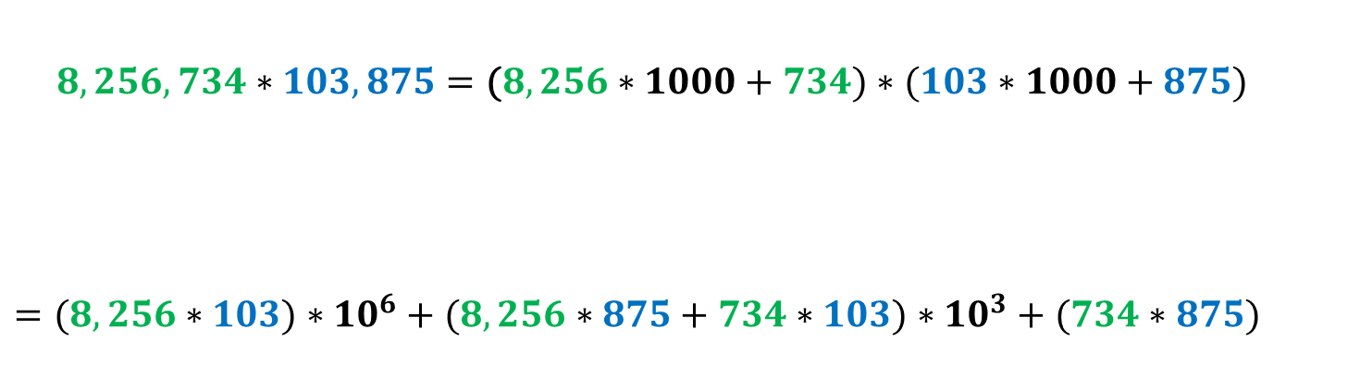
Example 4: Large Integer Multiplication
$$8,256,734∗103,875=\text{(}8,256∗1000+734)∗(103∗1000+875)$$
$$=(8,256∗103)∗{10}^{6}+(8,256∗875+734∗103)∗{10}^{3}+(734∗875)$$

Slide 50
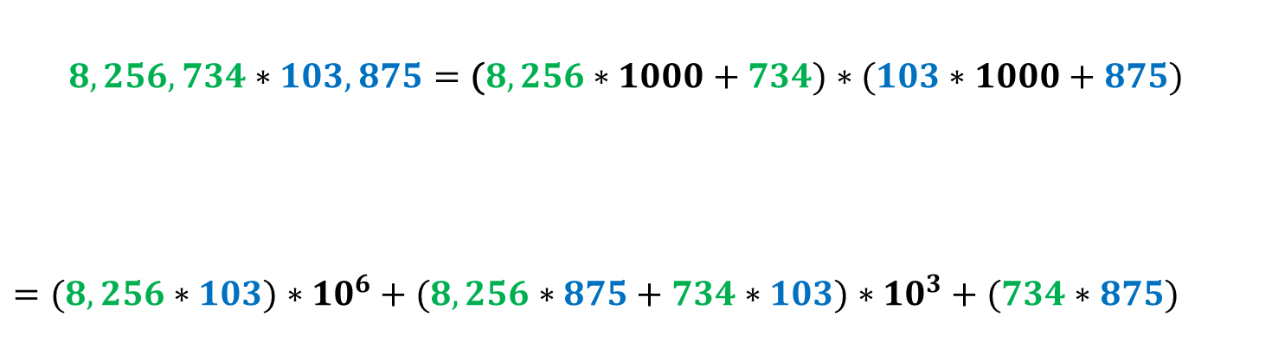
Example 4: Large Integer Multiplication
$$8,256,734∗103,875=\text{(}8,256∗1000+734)∗(103∗1000+875)$$
$$=(8,256∗103)∗{10}^{6}+(8,256∗875+734∗103)∗{10}^{3}+(734∗875)$$

Slide 51
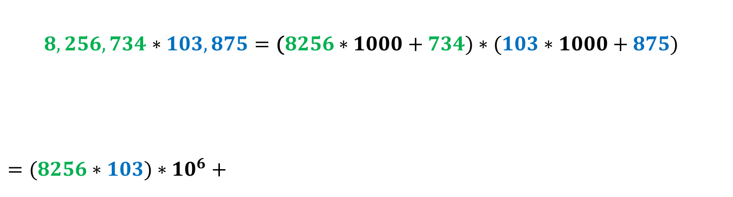
Example 4: Large Integer Multiplication
$8,256,734∗103,875=\text{(}8256∗1000+734)∗(103∗1000+875)$
$$=(8256∗103)∗{10}^{6}+$$

Slide 52
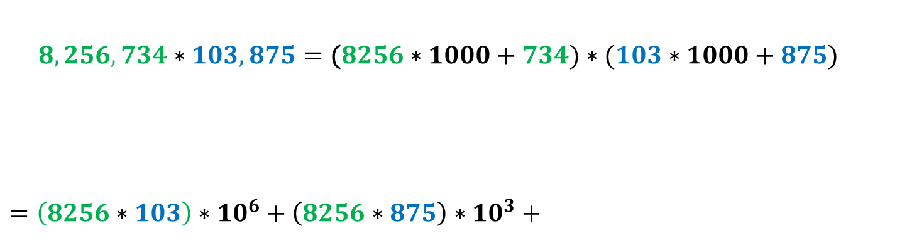
Example 4: Large Integer Multiplication
$8,256,734∗103,875=\text{(}8256∗1000+734)∗(103∗1000+875)$
$$=\left(8256∗103\right)∗{10}^{6}+\left(8256∗875\right)∗10^{3}+$$

Slide 53
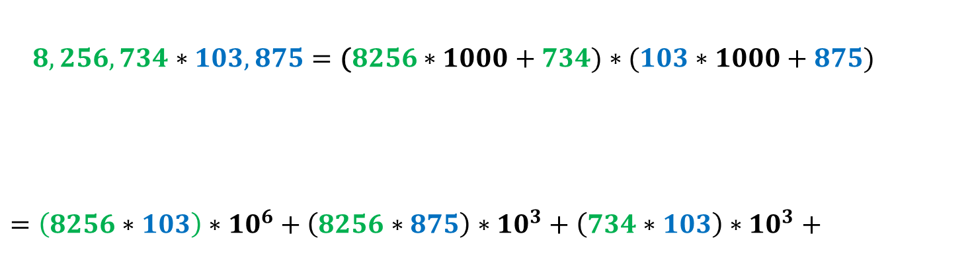
Example 4: Large Integer Multiplication
$8,256,734∗103,875=\text{(}8256∗1000+734)∗(103∗1000+875)$
$$=\left(8256∗103\right)∗{10}^{6}+\left(8256∗875\right)∗10^{3}+\left(734∗103\right)∗{10}^{3}+$$

Slide 54
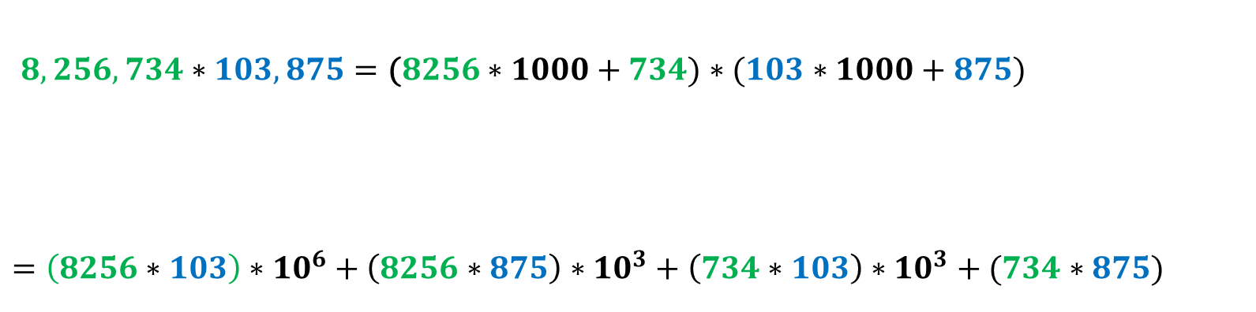
Example 4: Large Integer Multiplication
$8,256,734∗103,875=\text{(}8256∗1000+734)∗(103∗1000+875)$
$$=\left(8256∗103\right)∗{10}^{6}+\left(8256∗875\right)∗10^{3}+\left(734∗103\right)∗{10}^{3}+(734∗875)$$

Slide 55
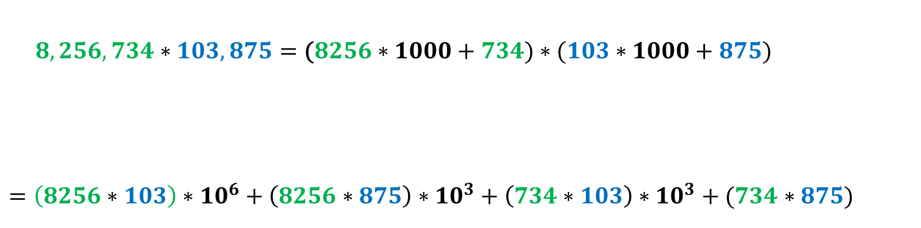
Example 4: Large Integer Multiplication
$8,256,734∗103,875=\text{(}8256∗1000+734)∗(103∗1000+875)$
$$=\left(8256∗103\right)∗{10}^{6}+\left(8256∗875\right)∗10^{3}+\left(734∗103\right)∗{10}^{3}+(734∗875)$$

Slide 56
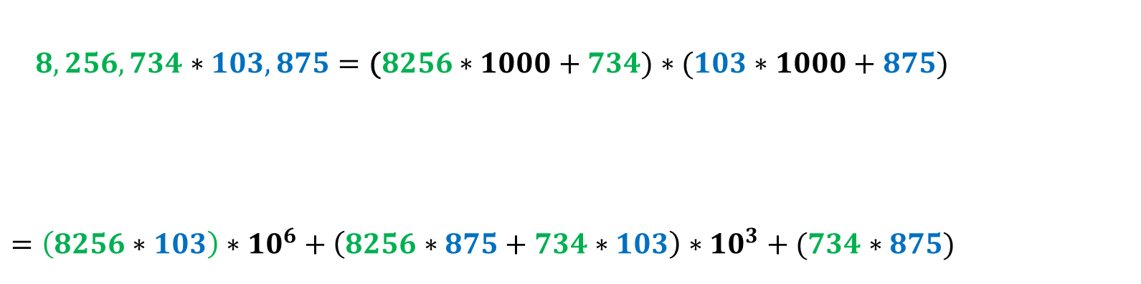
Example 4: Large Integer Multiplication
$8,256,734∗103,875=\text{(}8256∗1000+734)∗(103∗1000+875)$
$$=\left(8256∗103\right)∗{10}^{6}+\left(8256∗875+734∗103\right)∗{10}^{3}+(734∗875)$$

Slide 57
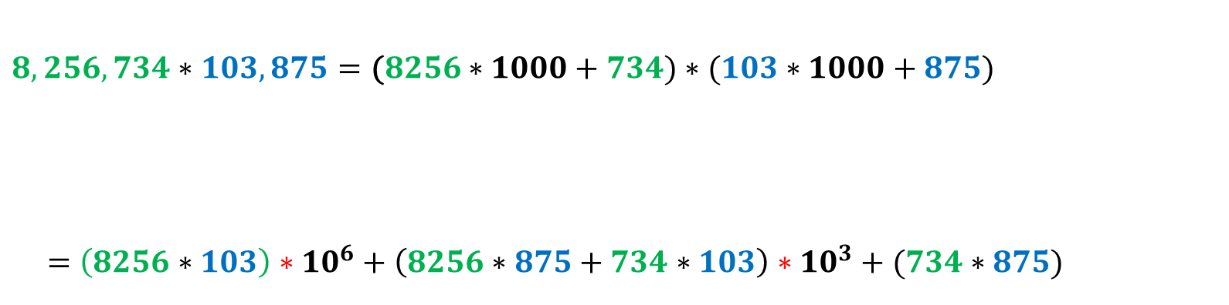
Example 4: Large Integer Multiplication
$$8,256,734∗103,875=\text{(}8256∗1000+734)∗(103∗1000+875)$$
$$=\left(8256∗103\right)∗{10}^{6}+\left(8256∗875+734∗103\right)∗{10}^{3}+(734∗875)$$
Not multiplication
4

Slide 58
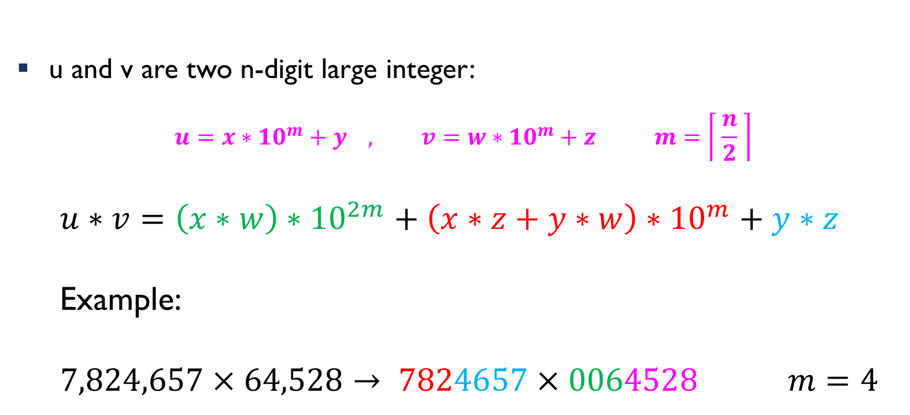
Example 4: Large Integer Multiplication
u and v are two n-digit large integer:
$$u=x∗{10}^{m}+y , v=w∗{10}^{m}+z m=\left\lceil \frac{n}{2} \right\rceil$$
$$u∗v=\left(x∗w\right)∗{10}^{2m}+\left(x∗z+y∗w\right)∗{10}^{m}+y∗z$$
Example:
$$7,824,657×64,528→ 7824657×0064528 m=4$$

Slide 59
L.I.M: Algorithm
multiply(u,v)
if(u==‘0’ or v==‘0’) return ‘0’
n1=u.size()
n2=v.size()
n=max(n1,n2)
if(n<threshold) return str(int(u)*int(v))
m=n/2
x,y=split(u)
w,z=split(v)
p=multiply(x,w)
for(i=0;i<2*m;i++) p=p+’0’
t1=multiply(x,z)
t2=multiply(y,w)
s=sum(t1,t2)
for(i=0;i<m;i++) s=s+’0’
q=multiply(y,z)
return sum(sum(p,s),q)

Slide 60
L.I.M: Algorithm
multiply(u,v)
if(u==‘0’ or v==‘0’) return ‘0’
n1=u.size()
n2=v.size()
n=max(n1,n2)
if(n<threshold) return str(int(u)*int(v))
m=n/2
x,y=split(u)
w,z=split(v)
p=multiply(x,w)
for(i=0;i<2*m;i++) p=p+’0’
t1=multiply(x,z)
t2=multiply(y,w)
s=sum(t1,t2)
for(i=0;i<m;i++) s=s+’0’
q=multiply(y,z)
return sum(sum(p,s),q)

Slide 61
L.I.M: Algorithm
multiply(u,v)
if(u==‘0’ or v==‘0’) return ‘0’
n1=u.size()
n2=v.size()
n=max(n1,n2)
if(n<threshold) return str(int(u)*int(v))
m=n/2
x,y=split(u)
w,z=split(v)
p=multiply(x,w)
for(i=0;i<2*m;i++) p=p+’0’
t1=multiply(x,z)
t2=multiply(y,w)
s=sum(t1,t2)
for(i=0;i<m;i++) s=s+’0’
q=multiply(y,z)
return sum(sum(p,s),q)

Slide 62
L.I.M: Algorithm
multiply(u,v)
if(u==‘0’ or v==‘0’) return ‘0’
n1=u.size()
n2=v.size()
n=max(n1,n2)
if(n<threshold) return str(int(u)*int(v))
m=n/2
x,y=split(u)
w,z=split(v)
p=multiply(x,w)
for(i=0;i<2*m;i++) p=p+’0’
t1=multiply(x,z)
t2=multiply(y,w)
s=sum(t1,t2)
for(i=0;i<m;i++) s=s+’0’
q=multiply(y,z)
return sum(sum(p,s),q)

Slide 63
L.I.M: Algorithm
multiply(u,v)
if(u==‘0’ or v==‘0’) return ‘0’
n1=u.size()
n2=v.size()
n=max(n1,n2)
if(n<threshold) return str(int(u)*int(v))
m=n/2
x,y=split(u)
w,z=split(v)
p=multiply(x,w)
for(i=0;i<2*m;i++) p=p+’0’
t1=multiply(x,z)
t2=multiply(y,w)
s=sum(t1,t2)
for(i=0;i<m;i++) s=s+’0’
q=multiply(y,z)
return sum(sum(p,s),q)

Slide 64
L.I.M: Algorithm
multiply(u,v)
if(u==‘0’ or v==‘0’) return ‘0’
n1=u.size()
n2=v.size()
n=max(n1,n2)
if(n<threshold) return str(int(u)*int(v))
m=n/2
x,y=split(u)
w,z=split(v)
p=multiply(x,w)
for(i=0;i<2*m;i++) p=p+’0’
t1=multiply(x,z)
t2=multiply(y,w)
s=sum(t1,t2)
for(i=0;i<m;i++) s=s+’0’
q=multiply(y,z)
return sum(sum(p,s),q)

Slide 65
L.I.M: Algorithm
multiply(u,v)
if(u==‘0’ or v==‘0’) return ‘0’
n1=u.size()
n2=v.size()
n=max(n1,n2)
if(n<threshold) return str(int(u)*int(v))
m=n/2
x,y=split(u)
w,z=split(v)
p=multiply(x,w)
for(i=0;i<2*m;i++) p=p+’0’
t1=multiply(x,z)
t2=multiply(y,w)
s=sum(t1,t2)
for(i=0;i<m;i++) s=s+’0’
q=multiply(y,z)
return sum(sum(p,s),q)

Slide 66
L.I.M: Algorithm
multiply(u,v)
if(u==‘0’ or v==‘0’) return ‘0’
n1=u.size()
n2=v.size()
n=max(n1,n2)
if(n<threshold) return str(int(u)*int(v))
m=n/2
x,y=split(u)
w,z=split(v)
p=multiply(x,w)
for(i=0;i<2*m;i++) p=p+’0’
t1=multiply(x,z)
t2=multiply(y,w)
s=sum(t1,t2)
for(i=0;i<m;i++) s=s+’0’
q=multiply(y,z)
return sum(sum(p,s),q)

Slide 67














multiply(array u,v)
if(u==‘0’ or v==‘0’) return ‘0’
n1=u.size()
n2=v.size()
n=max(n1,n2)
if(n<threshold) return str(int(u)*int(v))
m=n/2
x,y=split(u)
w,z=split(v)
p=multiply(x,w)
for(i=0;i<2*m;i++) p=p+’0’
t1=multiply(x,z)
t2=multiply(y,w)
s=sum(t1,t2)
for(i=0;i<m;i++) s=s+’0’
q=multiply(y,z)
return sum(sum(p,s),q
$$T(n)$$
$$O(1)$$
$$T\left(n\right)=O\left(n\right)+4T\left(\frac{n}{2}\right)$$
$$O(1)$$
$$T\left(1\right)=1$$
$$O(1)$$
$$T\left(\frac{n}{2}\right)$$
$$O(n)$$
$$T\left(\frac{n}{2}\right)$$
$$T\left(\frac{n}{2}\right)$$
$$O(n)$$
$$O(n)$$
$$T\left(\frac{n}{2}\right)$$
$$O(n)$$

Slide 68
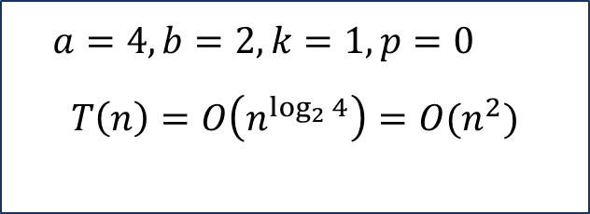
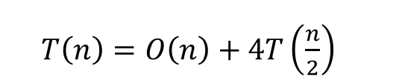
Time Complexity-Master theorem
$T\left(n\right)=O\left(n\right)+4T\left(\frac{n}{2}\right)$
$$T\left(n\right)=a T\left(\frac{n}{b}\right)+θ(n^{k}\log^{p}{n) }$$
$a=4, b=2, k=1,p=0$
$$T\left(n\right)=O\left(n^{\log_{2}{4}}\right){=O(n}^{2})$$
$$if a > b^{k}, then T\left(n\right)= θ\left(n^{\log_{b}{a}}\right)$$

Slide 69
LIM: Modification
$u∗v=\left(x∗w\right)∗{10}^{2m}+\left(x∗z+y∗w\right)∗{10}^{m}+y∗z$

Slide 70

LIM: Modification
$u∗v=\left(x∗w\right)∗{10}^{2m}+\left(x∗z+y∗w\right)∗{10}^{m}+y∗z$
$$x∗z+y∗w=\left(x+y\right)∗\left(z+w\right)−\left(x∗w\right)−(y∗z)$$
$$\left(x+y\right)\left(z+w\right)=$$
$$xz+xw+yz+yw=$$
$$\left(xz+yw\right)+\left(xw\right)+(yz)$$

Slide 71
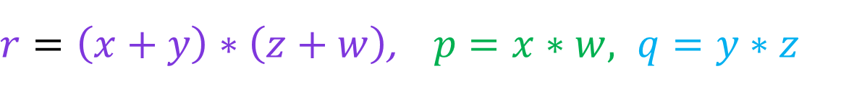
LIM: Modification
$u∗v=\left(x∗w\right)∗{10}^{2m}+\left(x∗z+y∗w\right)∗{10}^{m}+y∗z$
$$x∗z+y∗w=\left(x+y\right)∗\left(z+w\right)−\left(x∗w\right)−(y∗z)$$
$r=\left(x+y\right)∗\left(z+w\right)$, $p=x∗w, q=y∗z$
$u∗v=p∗{10}^{2m}+\left(r−p−q\right)∗{10}^{m}+q$

Slide 72
L.I.M: Algorithm
multiply(array u,v)
if(u==‘0’ or v==‘0’) return ‘0’
n1=u.size()
n2=v.size()
n=max(n1,n2)
if(n<threshold) return str(int(u)*int(v))
m=n/2
x,y=split(u)
w,z=split(v)
p=multiply(x,w)
for(i=0;i<2*m;i++) p=p+’0’
q=multiply(y,z)
s1=sum(x,y)
s2=sum(w,z)
r=multiply(s1,s2)
s=sum(r,-sum(p,q))
for(i=0;i<m;i++) s=s+’0’
return sum(sum(p,s),q)

Slide 73










multiply(array u,v)
if(u==‘0’ or v==‘0’) return ‘0’
n1=u.size()
n2=v.size()
n=max(n1,n2)
if(n<threshold) return str(int(u)*int(v))
m=n/2
x,y=split(u)
w,z=split(v)
p=multiply(x,w)
for(i=0;i<2*m;i++) p=p+’0’
q=multiply(y,z)
s1=sum(x,y)
s2=sum(w,z)
r=multiply(s1,s2)
s=sum(r,-sum(p,q))
for(i=0;i<m;i++) s=s+’0’
return sum(sum(p,s),q
$$T(n)$$
$$O(1)$$
$$T\left(n\right)=O\left(n\right)+3T\left(\frac{n}{2}\right)$$
$$O(1)$$
$$T\left(1\right)=1$$
$$O(1)$$
$$T\left(\frac{n}{2}\right)$$
$$O(n)$$
$$T\left(\frac{n}{2}\right)$$
$$O(n)$$
$$T\left(\frac{n}{2}\right)$$
$$O(n)$$
$$O(n)$$
$$O(n)$$

Slide 74

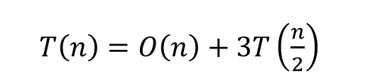
Time Complexity-Master theorem
$T\left(n\right)=O\left(n\right)+3T\left(\frac{n}{2}\right)$
$$T\left(n\right)=a T\left(\frac{n}{b}\right)+θ(n^{k}\log^{p}{n) }$$
$a=3, b=2, k=1,p=0$
$$T\left(n\right)=O\left(n^{\log_{2}{3}}\right){=O(n}^{1.58})$$
$$if a > b^{k}, then T\left(n\right)= θ\left(n^{\log_{b}{a}}\right)$$

Slide 75
Any Question??
Have a nice day!

